Slide 1
DeepLab
Project 2 – CSE 676
Amlan Gupta

Slide 2
Divider Slide
Section title

Slide 3
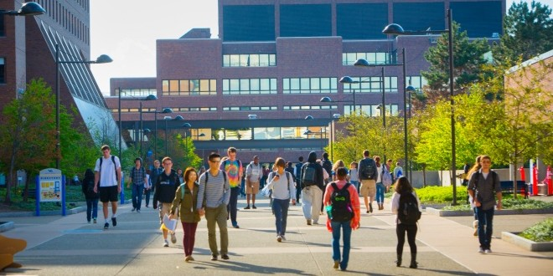

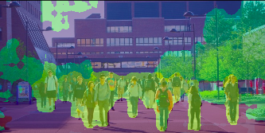
Agenda
Semantic Segmentation
DeepLab
Atrous convolution
Atrous Spatial Pyramid Pooling
A
B
C

Slide 4
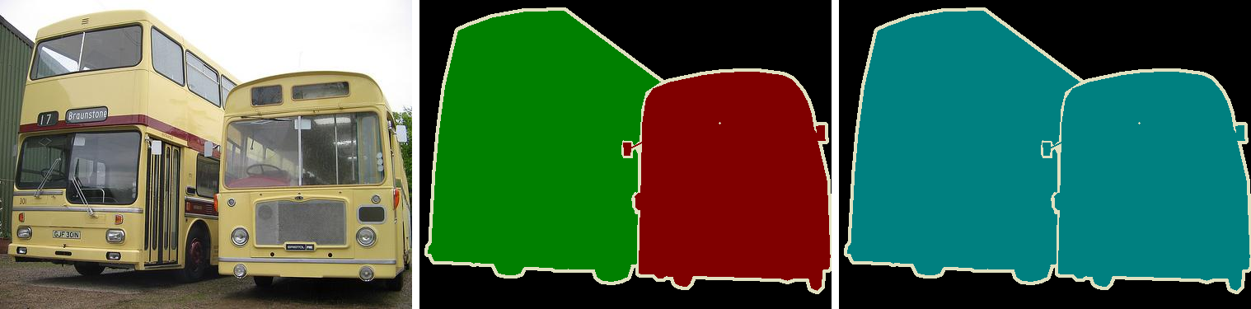
Semantic Segmentation
Different from image classification, in semantic segmentation we want to make decisions for every pixel in an image.
For each pixel, the model needs to classify it as one of the pre-determined classes. Segmentation means understanding images at a pixel level.
Instance Segmentation
Semantic Segmentation

Slide 5
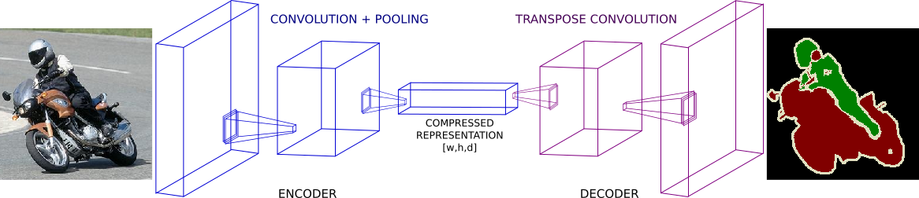
DeepLab 3+
DeepLab is a state-of-the-art semantic segmentation model designed and open-sourced by Google in 2016.
Multiple improvements have been made to the model since then, including DeepLab V2 , DeepLab V3 and the latest DeepLab V3+
Encoding phase: The aim of this phase is to extract essential information from the image.
Decoding phase: The information extracted in encoding phase is used here to reconstruct output of appropriate dimensions

Slide 6
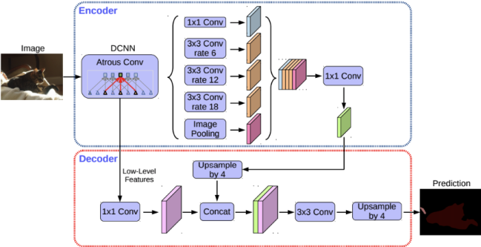
DeepLab 3+ Architecture
ResNet/Xception/MobileNetv3
Atrous convolutions
Atrous Spatial Pyramid Pooling (ASPP)
Depthwise Separable Convolutions
Depthwise convolution
Pointwise convolution

Slide 7

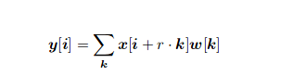
Atrous convolutions
Dilation Rate
A 3x3 kernel with a dilation rate of 2 will have the same field of view as a 5x5 kernel
Same computational cost for wider context

Slide 8
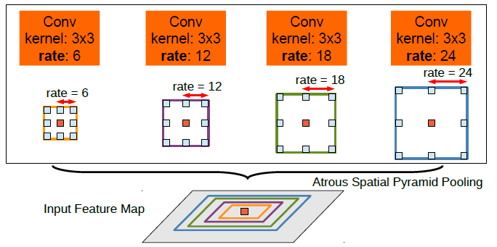
Atrous Spatial Pyramid Pooling (ASPP)
Captures multi-scale information
Pooling operations at multiple dilation rates
Incorporates image-level features via Global Average Pooling

Slide 9
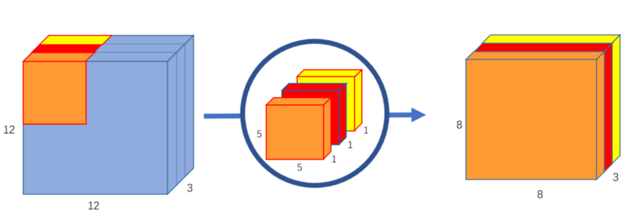
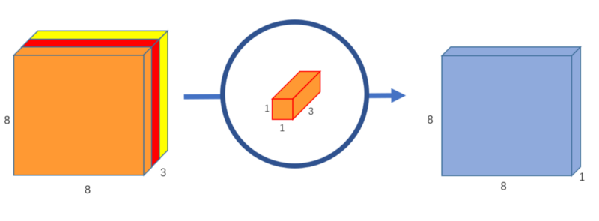
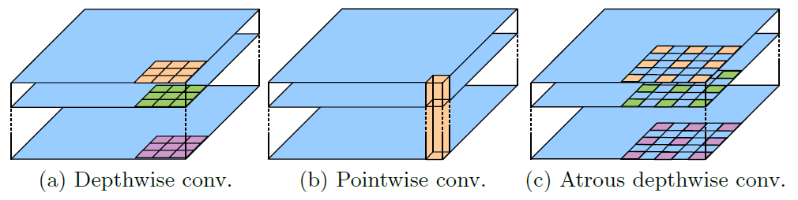
Depthwise Separable Convolutions
Depthwise convolution
Pointwise convolution
Atrous Depthwise Convolution

Slide 10
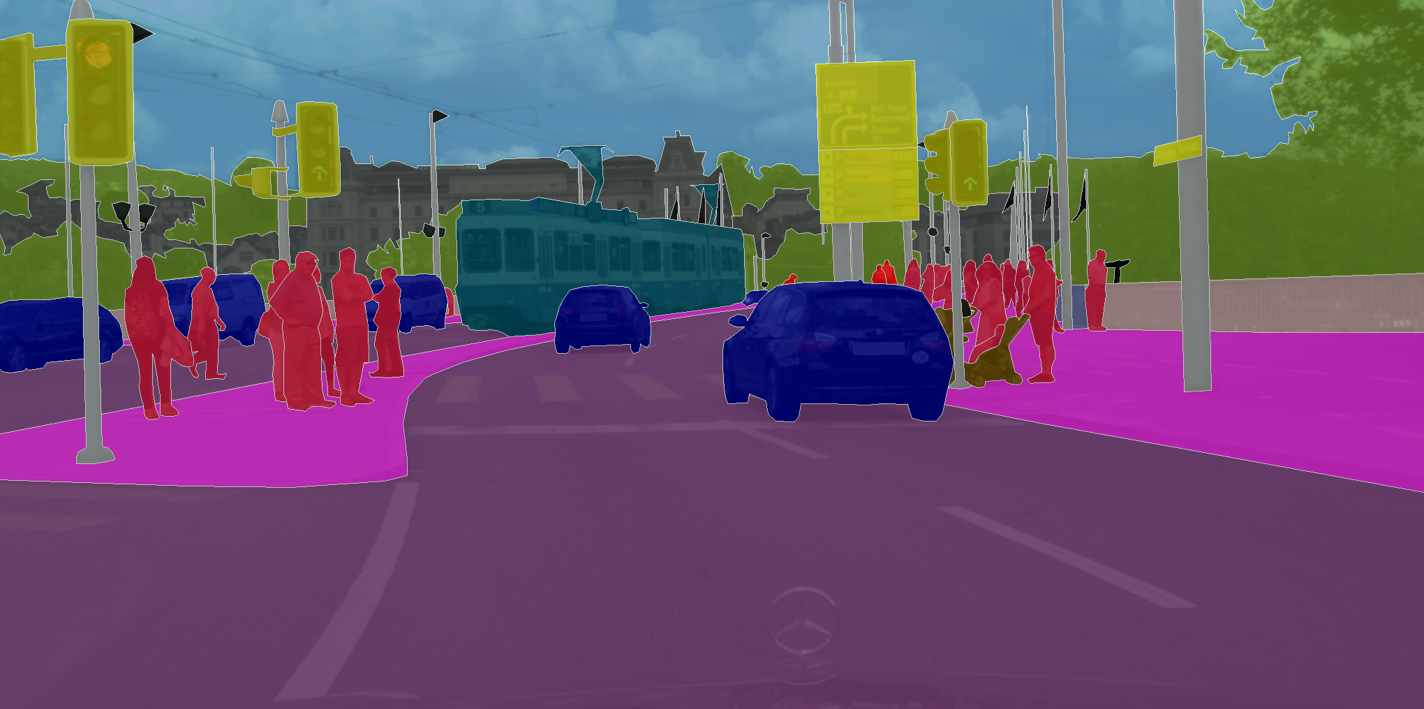
CityScapes Dataset
Type of annotations
Instance wise
Semantic
Dense –pixel Annotations
Complexity
30 classes (used 19 classes)
Volume
5000 annotated images with fine annotations.
20000 with coarse annotations

Slide 11
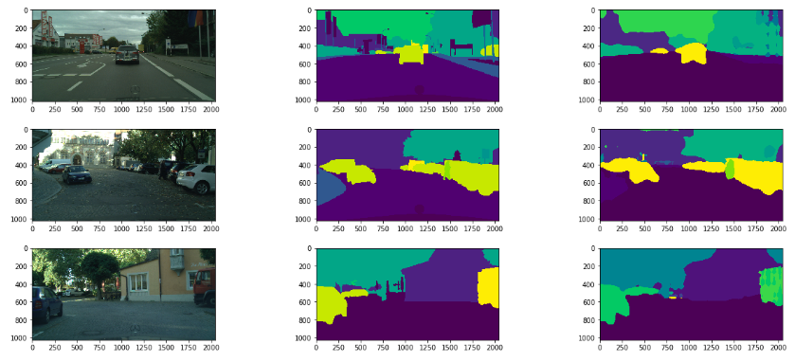
Result
Calculated Jaccard Index (IOU): 0.57

Slide 12
Steps to run project
Clone repo: https://github.com/nullbringer/deeplab/
Hit Run
(a few images has been included in the repo to simulate result)

Slide 13
References
https://towardsdatascience.com/the-evolution-of-deeplab-for-semantic-segmentation-95082b025571
https://towardsdatascience.com/review-deeplabv3-atrous-convolution-semantic-segmentation-6d818bfd1d74
https://arxiv.org/abs/1606.00915
https://arxiv.org/pdf/1802.02611.pdf
https://www.kaggle.com/alexanderliao/deeplabv3
https://github.com/bonlime/keras-deeplab-v3-plus
https://github.com/tensorflow/models/tree/master/research/deeplab
https://github.com/tensorflow/models/blob/master/research/deeplab/g3doc/cityscapes.md
https://github.com/Golbstein/Keras-segmentation-deeplab-v3.1/
https://github.com/JonathanCMitchell/mobilenet_v2_keras
https://github.com/dhkim0225/keras-image-segmentation
https://github.com/davidtvs/Keras-LinkNet
https://www.analyticsvidhya.com/blog/2019/02/tutorial-semantic-segmentation-google-deeplab/

